Slide 1
ZAS Academy
Python Curriculum for IOT & AI

Slide 2
Day5 - Agenda
Day 8
Blynking LED
Touch sensor
DHT11 sensor
Touch sensor Email
Ultrasonic sensor
Servo Motor

Slide 3
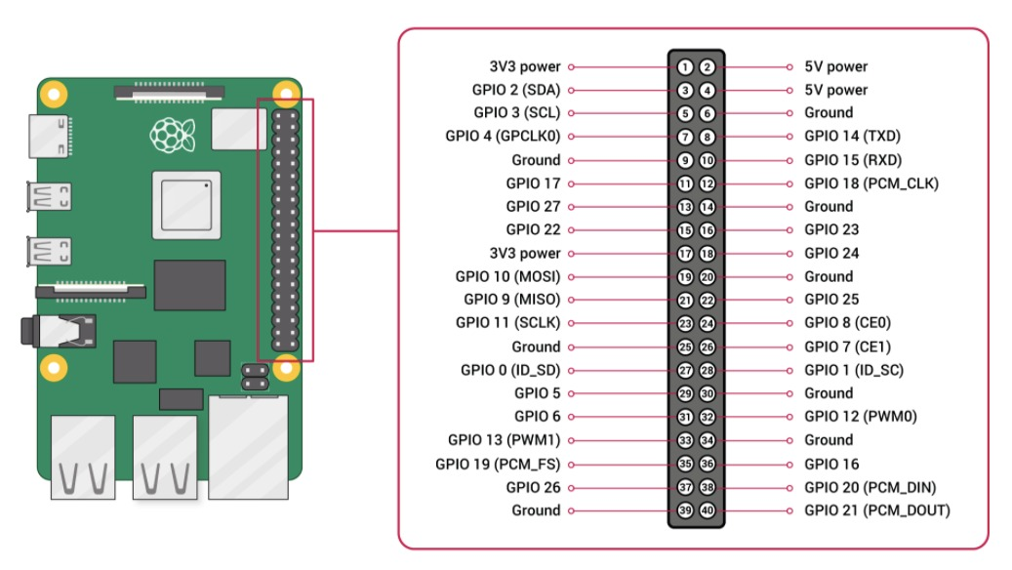
Pi Pin Diagram

Slide 4
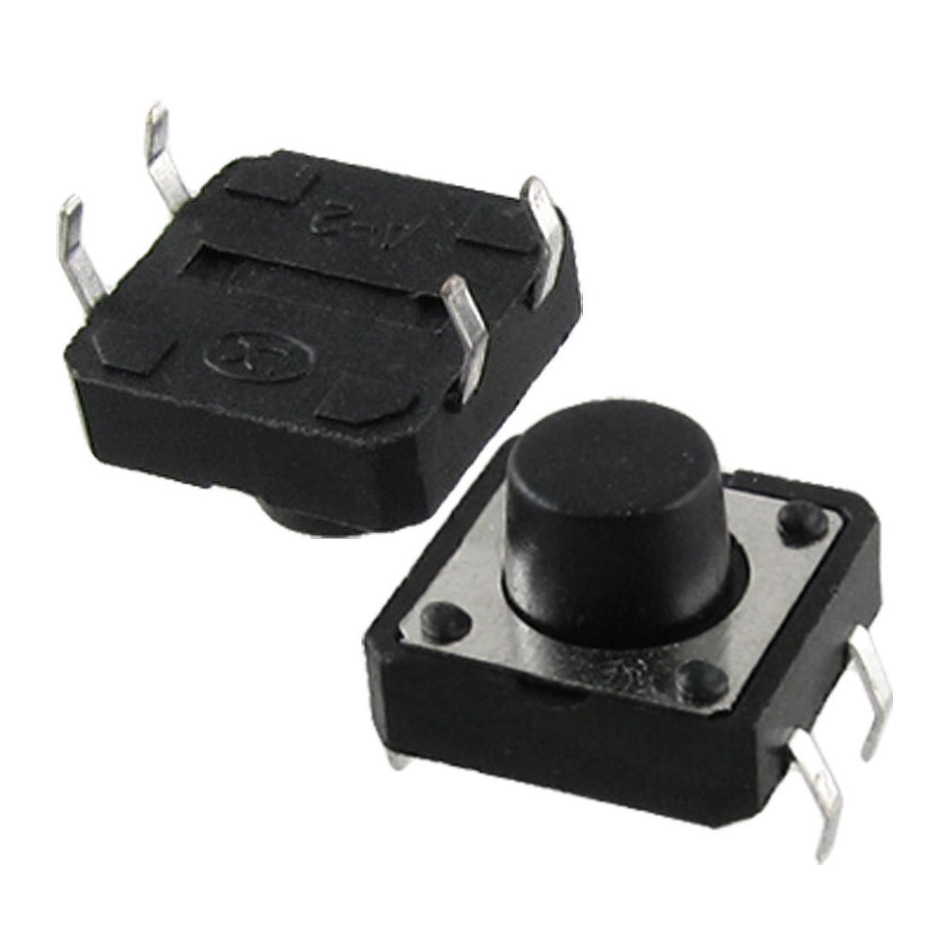
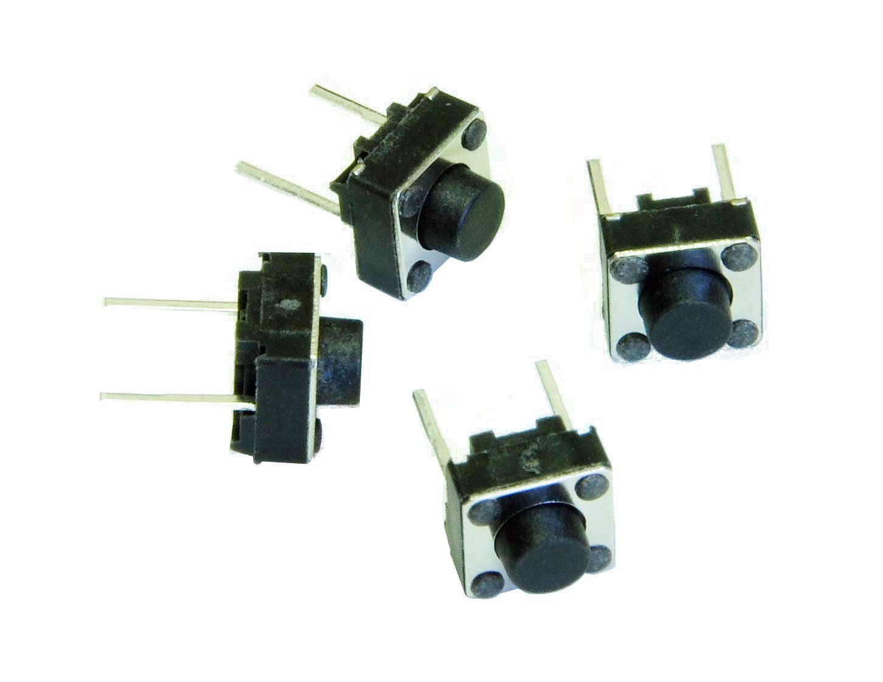
Switch

Slide 5
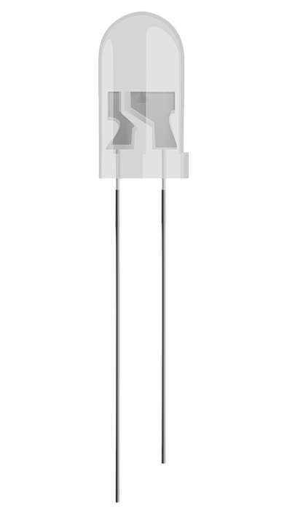
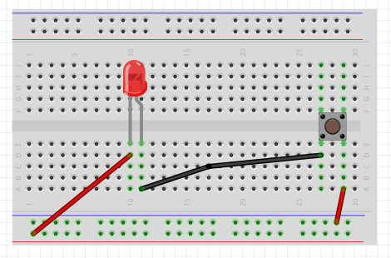
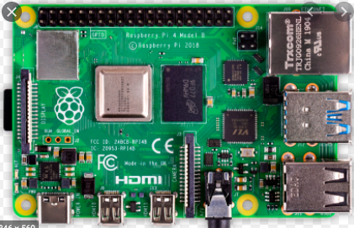
LED, Battery and Switch
Long leg - positive
Short leg - Negative
Positve

Slide 6
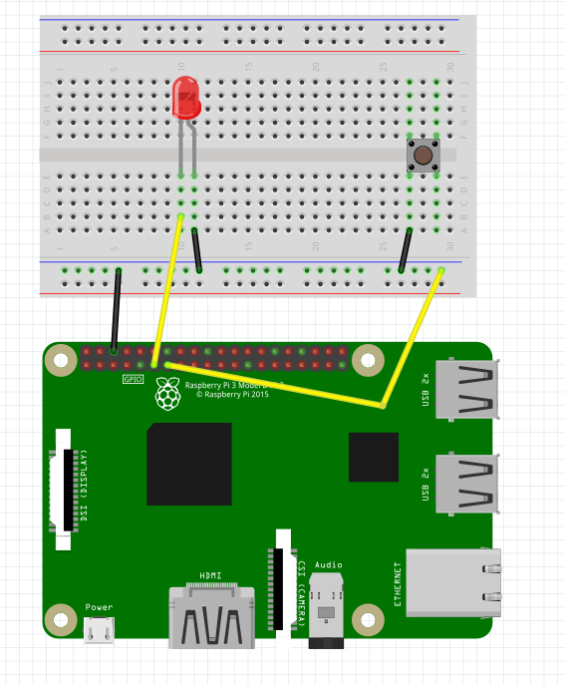
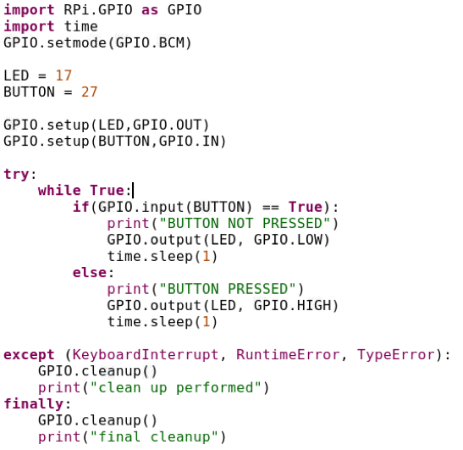
Button
Input GPIO Pins are Pulled High by default

Slide 7
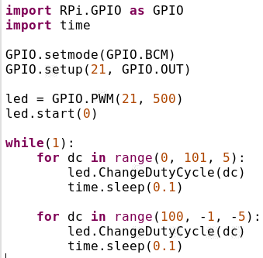
PWM Pins

Slide 8
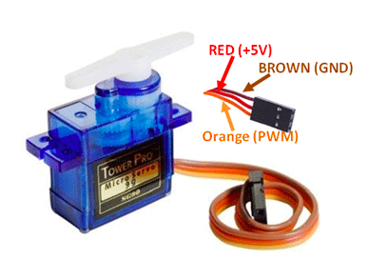
Servo Motor

Slide 9
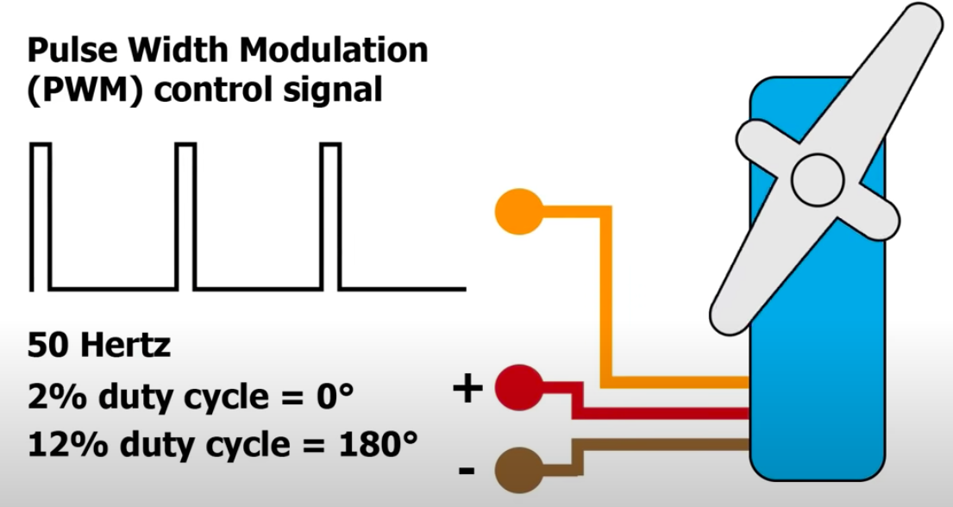
Operation of Servo

Slide 10
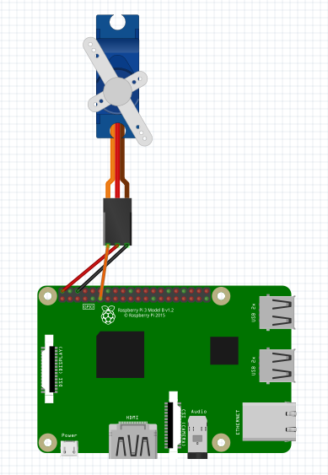
Servo Connections

Slide 11
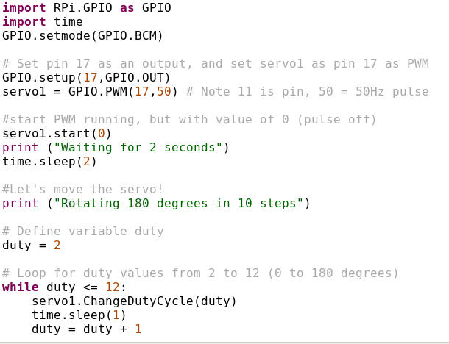
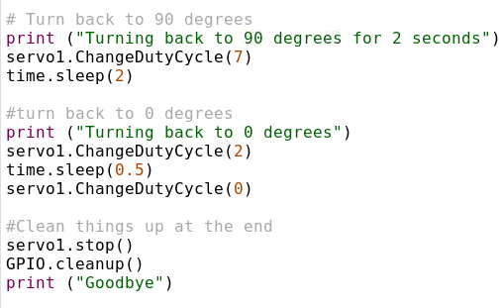
Servo Code (servo.py)

Slide 12
Servo Code (servo_no_jitter.py), (servo_go_to_angle.py)

Slide 13
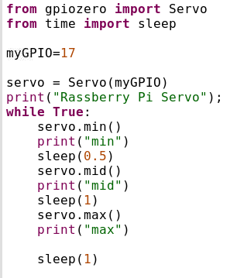
Servo Code (with library)

Slide 14
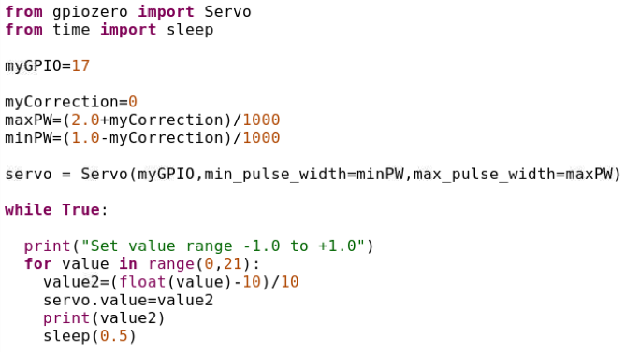
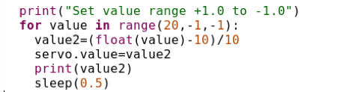
Servo_with_library_2

